Slide 1

A new nonprofit dedicated to helping Floridians understand how Florida’s behavioral health system works and how to advocate to make it better.
Navigating Florida’s Behavioral Health System
Presented by:

Slide 2


Your Co-Hosts
Amy McClellan
Board President, Florida Advocates for Behavioral Health
Board President, Key Clubhouse of South Florida
Board Director, Florida Mental Health Advocacy Coalition
Gayle Giese
Board President, Florida Mental Health Advocacy Coalition
Board Director, Florida Advocates for Behavioral Health Coalition
NAMI Broward Advocacy Group Chair

Slide 3
A new nonprofit dedicated to helping Floridians understand how Florida’s behavioral health system works and how to advocate to make it better.
A learning community with the mission to educate citizens on behavioral health issues and policies to improve the lives of individuals and families living with behavioral health conditions while decreasing stigma through increased understanding.
floridaadvocates.org
Florida Advocates for Behavioral Health is a tax-exempt organization under the Internal Revenue Code Section 501(c)3. Contributions to Florida Advocates for Behavioral Health are deductible as qualified charitable contributions.

Slide 4

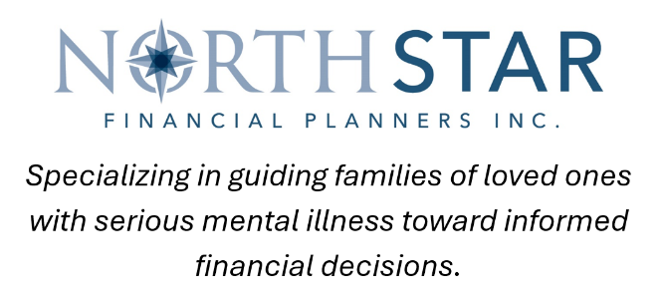

Thank you to our sponsors!
Please note that the views expressed by the speakers in this webinar do not necessarily reflect those of Florida Advocates for Behavioral Health. Moreover, Florida Advocates for Behavioral Health does not endorse any treatments or therapies as expressed by the speakers.

Slide 5
Meet Our Panelists
Suzette B. Fleischmann, LMHC, Vice President, Contracts and Quality Assurance, United Way of Broward County
Former Southeast Regional Director and statewide Interim Director, Office of Substance Abuse and Mental Health, Florida Department of Children & Families
Silvia Quintana, CEO, Broward Behavioral Health Coalition
Cecile Franklin, Office of Economic Self-Sufficiency (OESS), Regional Policy Manager Southeast Region, Florida Department of Children and Families

Slide 6
Overview of the
Behavioral Health System
Suzette B. Fleischmann, LMHC
Vice President, Contracts and Quality Assurance
United Way of Broward County

Slide 7
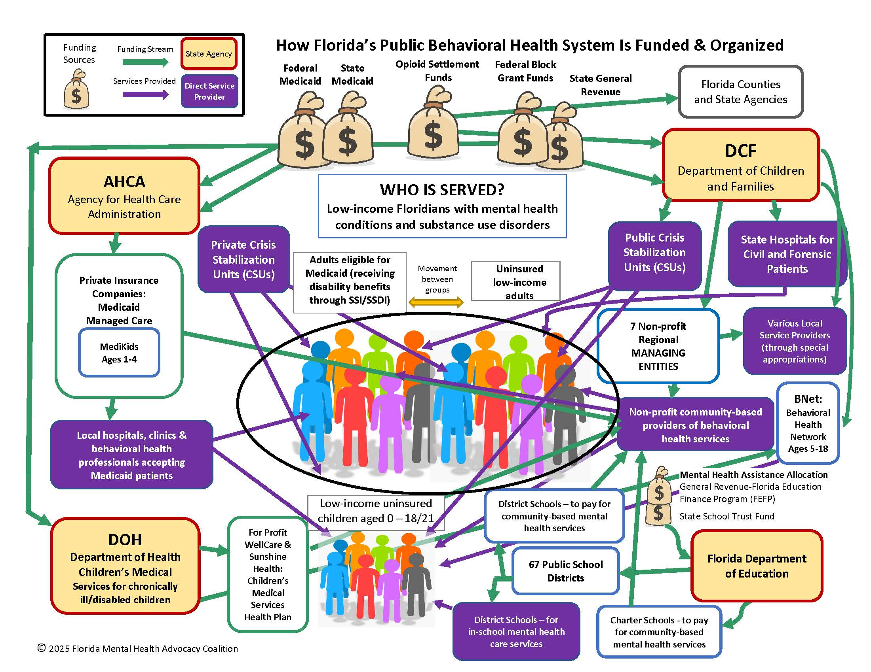

Slide 8
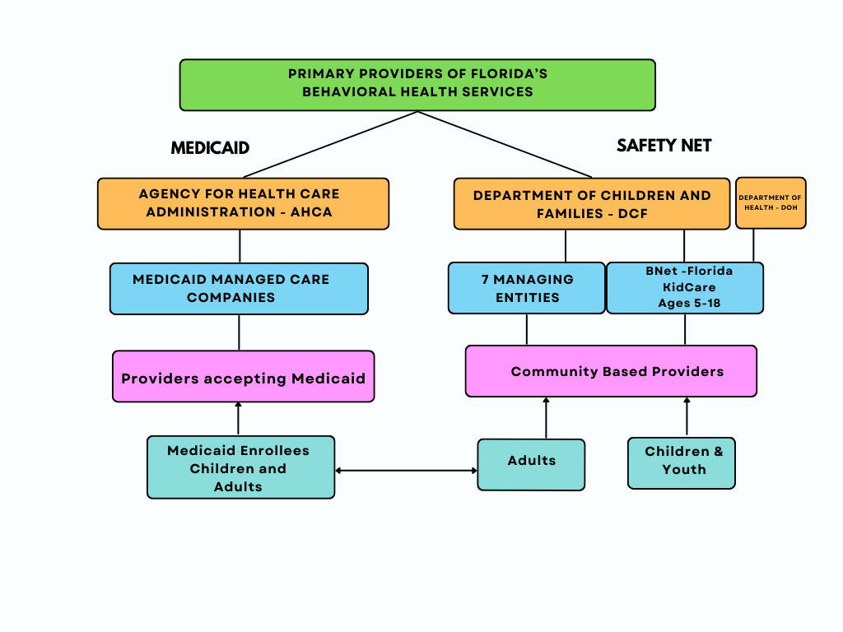
Notes:
DELETE MEDICARE!

Slide 9
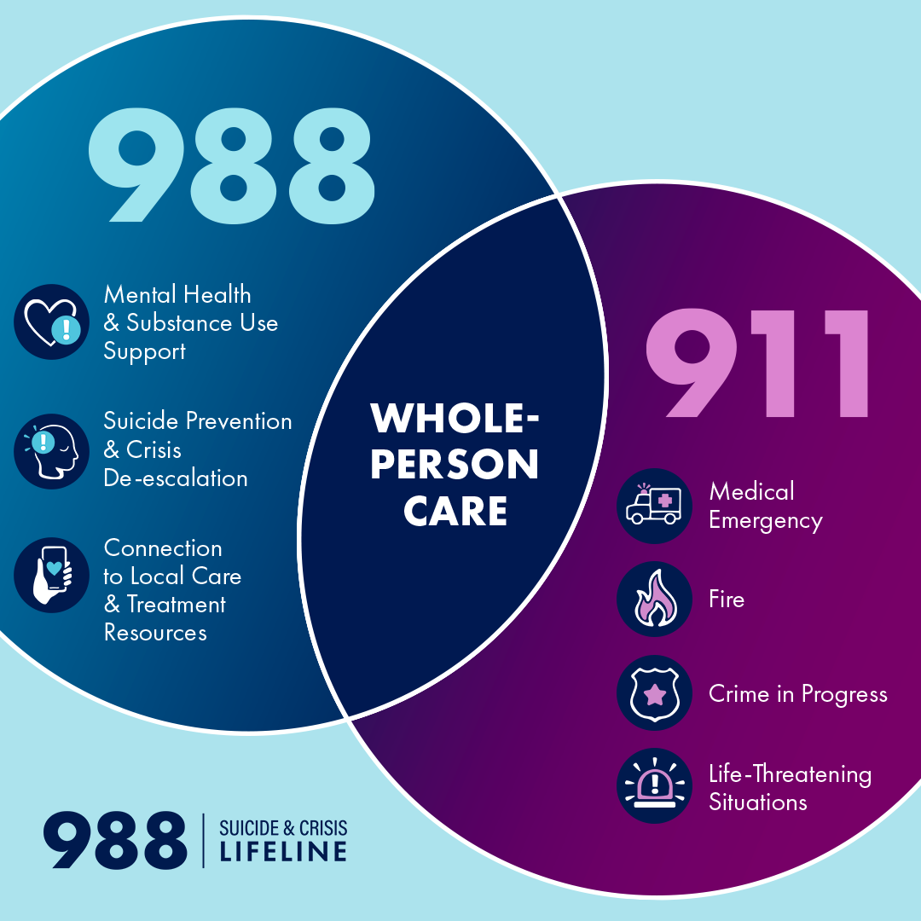


Get connected to essential community services.
Notes:
Links for resources: https://www.samhsa.gov/mental-health/988 https://988floridalifeline.com/

Slide 10
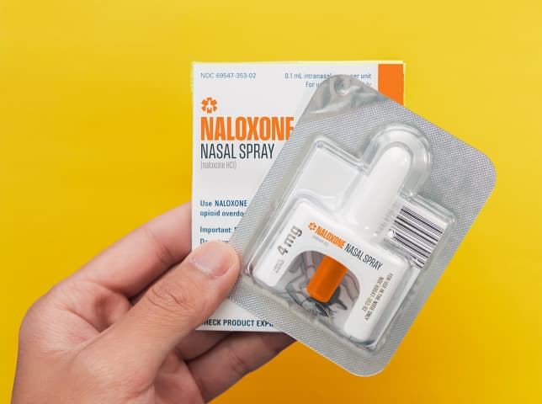
In an Opioid Overdose Situation
(Heroin, Fentanyl, Prescription Painkillers)
Call 911 and say: “Someone is unresponsive and not breathing.” Follow instructions.
Administer NARCAN (Naloxone) Nasal Spray, which can instantly reverse an opioid overdose and restore breathing.
To locate free NARCAN, go to www.isavefl.com
The SAMHSA (Substance Abuse Mental Health
Services Administration) Opioid Overdose
Prevention Toolkit link is provided on our Quick
Guide Resource Pages (to be shown at end of webinar
and available on the floriadadvocates.org website).

Slide 11
Managing Entities
Services and Programs
Silvia M. Quintana, LMHC, CAP
Chief Executive Officer

Slide 12

Who are we?
Managing Entities were created by the Florida Legislature.
We are private non-profit organizations.
MEs are procured by the Florida Department of Children and Families (DCF) to provide the administration, management, support and oversight of the State and Federally funded behavioral health services.

Slide 13
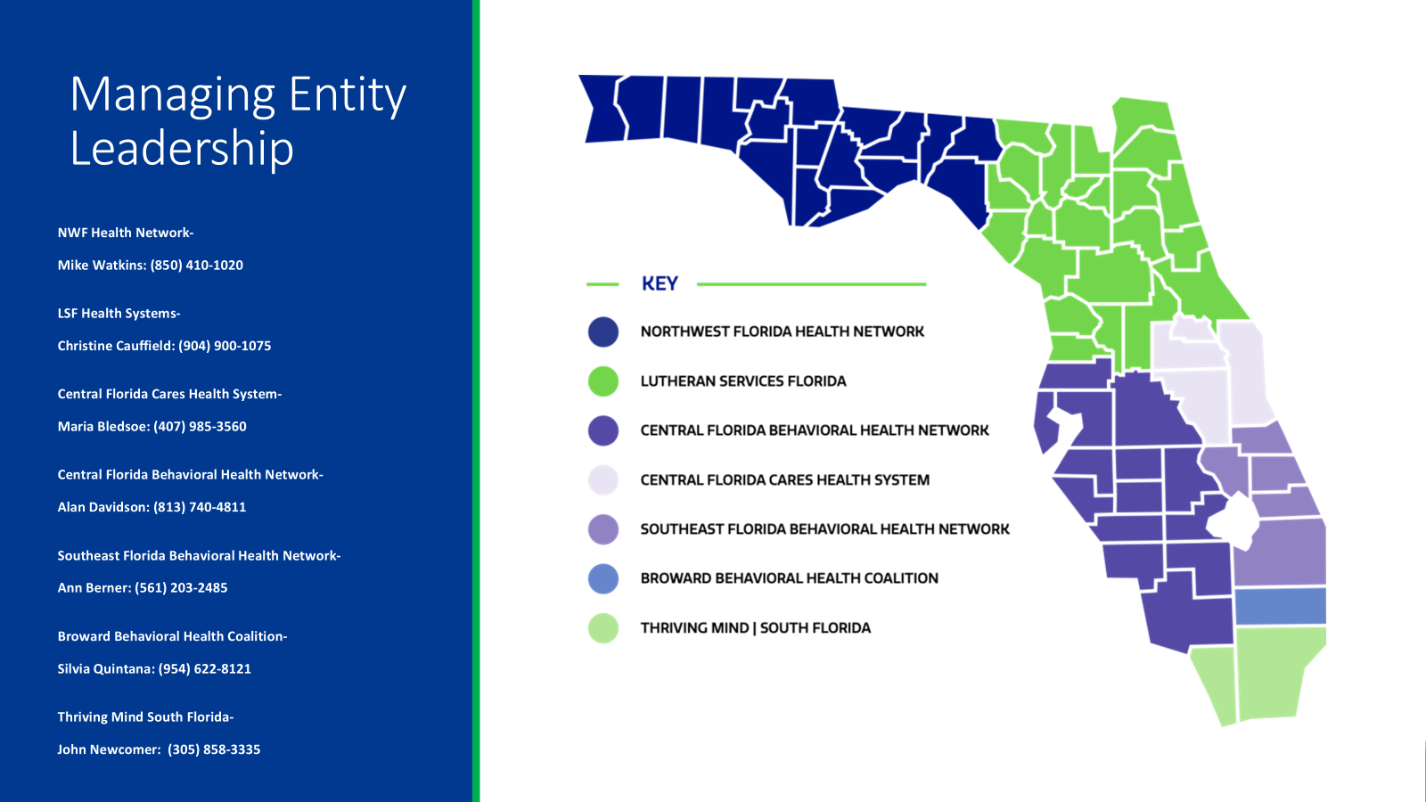
Notes:
LEADER NAMES ARE TOO SMALL. RE-DO AND ENLARGE.

Slide 14
What do we do?
Contract with a behavioral health network of treatment and recovery support providers.
Develop innovative programs to meet the needs of the community.
Build capacity, provide training and technical assistance to the network providers.
Continue to improve the system of care in Florida in collaboration with local Community Partners.

Slide 15
Managing Entities Network
Comprised of over 300 providers statewide, MEs contract for prevention, treatment and recovery support and crisis services.
Services are provided to adults, youth, children and their families with mental health and/or substance use disorders.
We use a recovery-oriented system of care approach that utilizes Evidence Based Practices (EBP’s).
Through our network we provide:
    Adult Residential Services
    Adult Non-Residential Services
    Children/Youth Non-Residential Services
    Children Residential Services
    Adults, Children and families Support Services
    Emergency Services

Slide 16
Services Funded
Addiction Receiving Facility (ARF, JARF)
Aftercare
Assessment
Case Management/Wellness/Life Coaches
Community Action Team (CAT)
Care Coordination Team
Child Welfare Care Coordination Team (CCT-CW)
Central Receiving Center (CRC)
Clubhouse
Crisis services
Drop-In Centers
Crisis Stabilization/Emergency
Crisis Support – Mobile Crisis/Response Team
Day Treatment
Detoxification (Residential and outpatient)
Florida Assertive Community Treatment (FACT)
Family Intensive Treatment Team (FITT )
Forensic Multi-disciplinary Team
Incidental / Flexible Funds
Information and Referral
In-Home / On-Site
Inpatient
Intervention
Medical Services/Psychiatric
Medication Assisted Treatment (MAT)
Mobile Response Teams
Outpatient
Outreach
Prevention
Recovery and Peer Support Services
Residential
Short-Term Residential Treatment (SRT)
Suicide Prevention/Intervention 988
Supported Employment / Education
Supportive Housing / Living
TASC

Slide 17
Multidisciplinary Teams
Florida Assertive Community Teams – (FACT) adults
Children Assertive Community Teams – (CAT) children and families
Family Intensive Teams – (FIT) family
Family Support Teams - family, child focused
High Acuity Team – adults (step-down FACT)
Care Coordination Teams - adult, youth, families

Slide 18
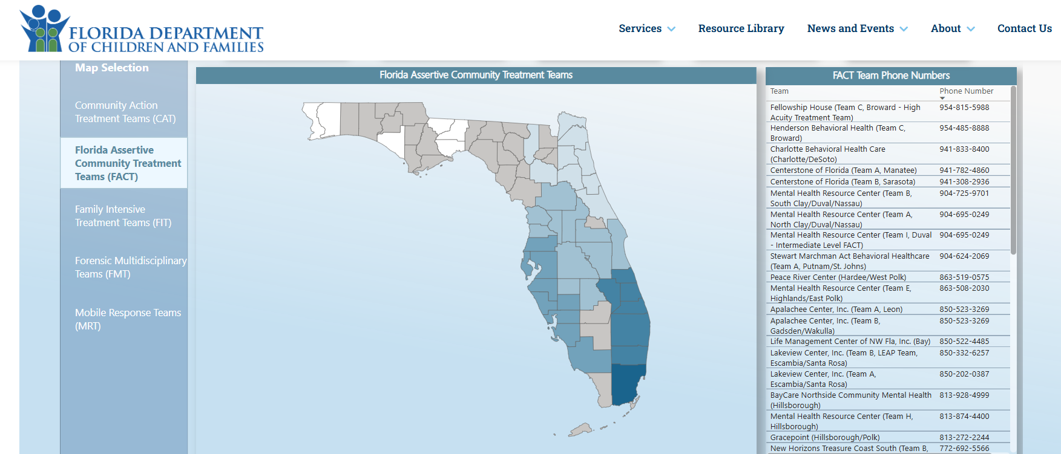
Managing Entity Specialty Teams

Slide 19
Evidence-Based Practices (EBP)
Scientifically proven strategies for successful outcomes
      Motivational Interviewing
      Wellness Recovery Action Planning (WRAP) including Facilitator Training/WHAM
      Mental Health First Aid – Adult and Youth
      Trauma Focused Cognitive Behavioral Therapy (TF CBT) Children
      Trauma Incident Reduction (TIR) Therapy for Adults and Youth
      Infant Mental Health
      Wraparound
      Transition to Independence Process (TIP) for transition age Youth 14-29
      Crisis Intervention Team (CIT) Training for Law Enforcement
      Supportive Housing
      IPS Supported Employment/Education
      International-Model Clubhouses
      TMACT for FACT Teams
      Critical Time Intervention (CTI) for Care Coordination
      Locus and CALocus level of care assessment and/ or ASAM

Slide 20
Care Coordination
Organized activities to coordinate individualized and holistic care.
Assists individuals who are not yet fully connected and engaged with the services and supports they want and need.
Collaboration across systems and providers to assist with successful transition from higher levels of care to community-based care.
Implementation of the Evidence-Based Practice – Critical Time Intervention (CTI)
Care coordination is provided at the funder level and at the Provider level.

Slide 21
Peer Organizations
Our wellness community organizations, their leaders, and members have a singular goal:
“Enhance the quantity and quality of support” that is available to people seeking and experiencing long-term recovery from mental health and/or addiction
All Managing Entities contract with Recovery Community Organizations (RCOs).

Slide 22
SOAR
SSI/SSDI Outreach, Access, and Recovery (SOAR) is a national program designed to increase access to Social Security Administration (SSA) disability benefits for eligible individuals who are experiencing or at risk of homelessness and have a mental illness, medical impairment, and/or a co-occurring substance use disorder.
The Managing Entities serve as the local SOAR leads for their regions. Contact your Managing Entity to find a SOAR-trained case worker. SOAR services are FREE.

Slide 23
Medicaid and Behavioral Health
Cecile Franklin
Regional Policy Manager, Southeast Region
Office of Economic Self-Sufficiency (OESS), Florida Department of Children and Families

Slide 24
Medicaid and Behavioral Health
Individuals living with serious behavioral health conditions have two routes to qualify for Medicaid in Florida:
Apply for SSI/SSDI – automatically qualifies the person for Medicaid and/or Medicare
Apply for Medicaid directly through the Department of Children and Families (DCF)

Slide 25
Medicaid and Behavioral Health
Who is eligible for Medicaid in Florida?
Adults who are pregnant or the parent of children up to age 18 and meet income level requirements
Adults who are disabled and meet income level requirements
Adults who are 65 or older and meet income level requirements
Children up to age 21 who meet income level requirements
X Adults who are not disabled and/or pregnant and/or who are not the parent of young children are NOT qualified.

Slide 26
Medicaid and Behavioral Health
How is disability defined by the state?
The disability must prevent the individual from working and be expected to last at least 12 months or be expected to result in death.
Children may be considered disabled if they have a medical condition which is considered a disabling condition for an adult.

Slide 27
Medicaid and Behavioral Health
What is Medicaid Managed Care?
The Statewide Medicaid Managed Care (SMMC) program enrolls most Medicaid recipients into managed care plans for their healthcare services.
These plans are provided by private health care organizations, based on where you live.
Plans cover primary and behavioral health care, and some dental care.

Slide 28
Medicaid and Behavioral Health
When to apply for SSI/SSDI benefits plus Medicaid and/or Medicare if you have a behavioral health condition that interferes with your ability to work or attend school?
Apply ASAP!
FREE application services for people with mental health conditions available through SOAR teams, available at your local community mental health agencies
SOAR accelerates the approval process, decreases denials
SSI/SSDI Outreach, Access and Recovery

Slide 29
Medicaid and Behavioral Health
How to apply through the Department of Children and Families
DCF’s website:
www.myflorida.com/accessflorida
www.myflfamilies.com/services/public-assistance
Family resource Center (DCF site). Search by zip code, county, city.
Family Resource Centers | Florida DCF
At an ACCESS Community Partner Site. Search by zip code, county, city.
https://myaccess.myflfamilies.com/Public/CPCS

Slide 34
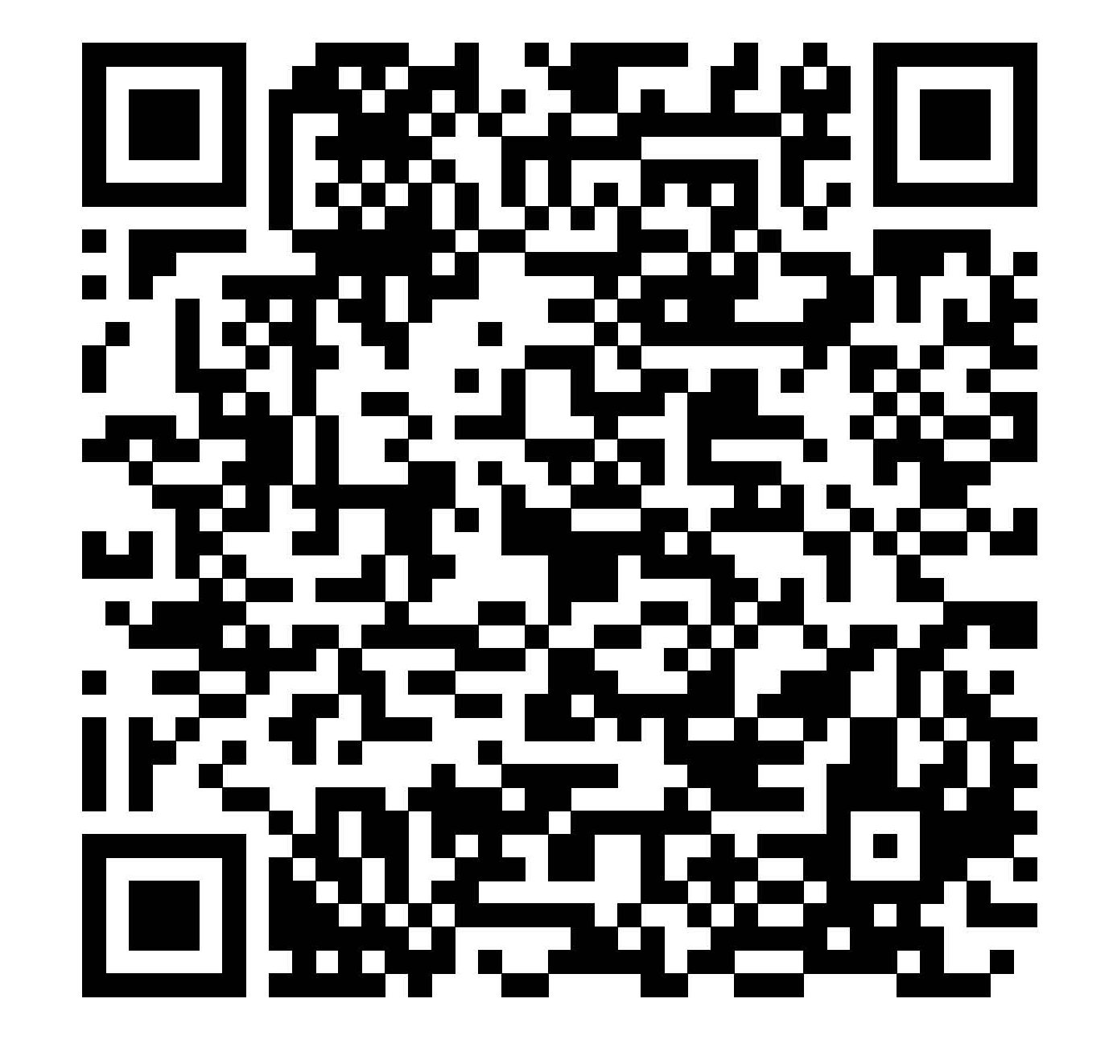
Scan the QR Code to download the
QUICK GUIDE TO BEHAVIORAL HEALTH RESOURCES

Slide 35
Q & A
Please put your questions in the Q&A box at the bottom of your Zoom screen.
??????????????????????????????????????????????????????????????????????????????????????

Slide 36
Be sure to complete the survey following the webinar to tell us how we did and to suggest future topics that you want to learn about!

Slide 37
THANK YOU AGAIN TO OUR SPONSORS:
www.newporthealthcare.com
www.csteam360.com
www.northstarplanners.com
Please note that the views expressed by the speakers do not necessarily reflect those of Florida Advocates for Behavioral Health. Moreover, Florida Advocates for Behavioral Health does not endorse any treatments or therapies as expressed by the speakers.

Slide 38
A new nonprofit dedicated to helping Floridians understand how Florida’s behavioral health system works and how to advocate to make it better.
Feel free to contact your co-hosts:
Amy McClellan, amyjmcclellan@gmail.com Gayle Giese, giesegayle@gmail.com
If you enjoyed our free webinar and believe in our mission, please visit our website and sign up for future webinars. Please also consider a donation to continue our work:
www.floridaadvocates.org
Florida Advocates for Behavioral Health is a tax-exempt organization under the Internal Revenue Code Section 501(c)3. Contributions to Florida Advocates for Behavioral Health are deductible as qualified charitable contributions.

