Slide 1

A new nonprofit dedicated to helping Floridians understand how Florida’s behavioral health system works and how to advocate to make it better.
TRIANGLE FOR RECOVERY
Where patient, provider, and family work together
so that no one falls through the cracks
Presented by:

Slide 2

Our Hosts
Katherine Murphy
  CEO, NAMI Palm Beach County
  Secretary, Florida Advocates for Behavioral Health
  Board Member, Florida Mental Health Advocacy Coalition
Amy McClellan
  Board President, Florida Advocates for Behavioral Health
  Board President, The Key Clubhouse of South Florida
  Board Member, Florida Mental Health Advocacy Coalition
  Mother and grandmother of children with mental illness

Slide 3
A nonprofit dedicated to helping Floridians understand how Florida’s behavioral health system works and how to advocate to make it better.
FAB is a learning community with the mission to educate citizens on behavioral health issues and policies to improve the lives of individuals and families living with behavioral health conditions while decreasing stigma through increased understanding.
floridaadvocates.org
Florida Advocates for Behavioral Health is a tax-exempt organization under the Internal Revenue Code Section 501(c)3. Contributions to Florida Advocates for Behavioral Health are deductible as qualified charitable contributions.
Notes:
AMY – welcomes everyone and continues through slide 6

Slide 4

Thank You to Our Webinar Sponsor!
Please note that the views expressed by the speakers in this webinar do not necessarily reflect those of Florida Advocates for Behavioral Health. Moreover, Florida Advocates for Behavioral Health does not endorse any treatments or therapies as expressed by the speakers.

Slide 5
Why This Webinar?
In meetings of the Florida Mental Health Advocacy Coalition and NAMI Family Support Groups, families share frustration that they are left out of the treatment planning process.
Attendees of our last webinar rated this as their first choice as a webinar topic.
Many family caregivers, psychiatrists, and patient/peers believe that working together collaboratively will achieve the best outcomes.
Notes:
Note that Families are often the most likely support system during and after treatment.

Slide 6

Adults with SMI Living with Family
Research suggests that
30-50% of adults with serious mental illness live with family members, usually parents.
Families provide housing, financial support, medication monitoring, crisis intervention, and sometimes case management.
Notes:
Amy, I got this info. from Alpert JFS in a recent webinar they did about housing options.

Slide 7
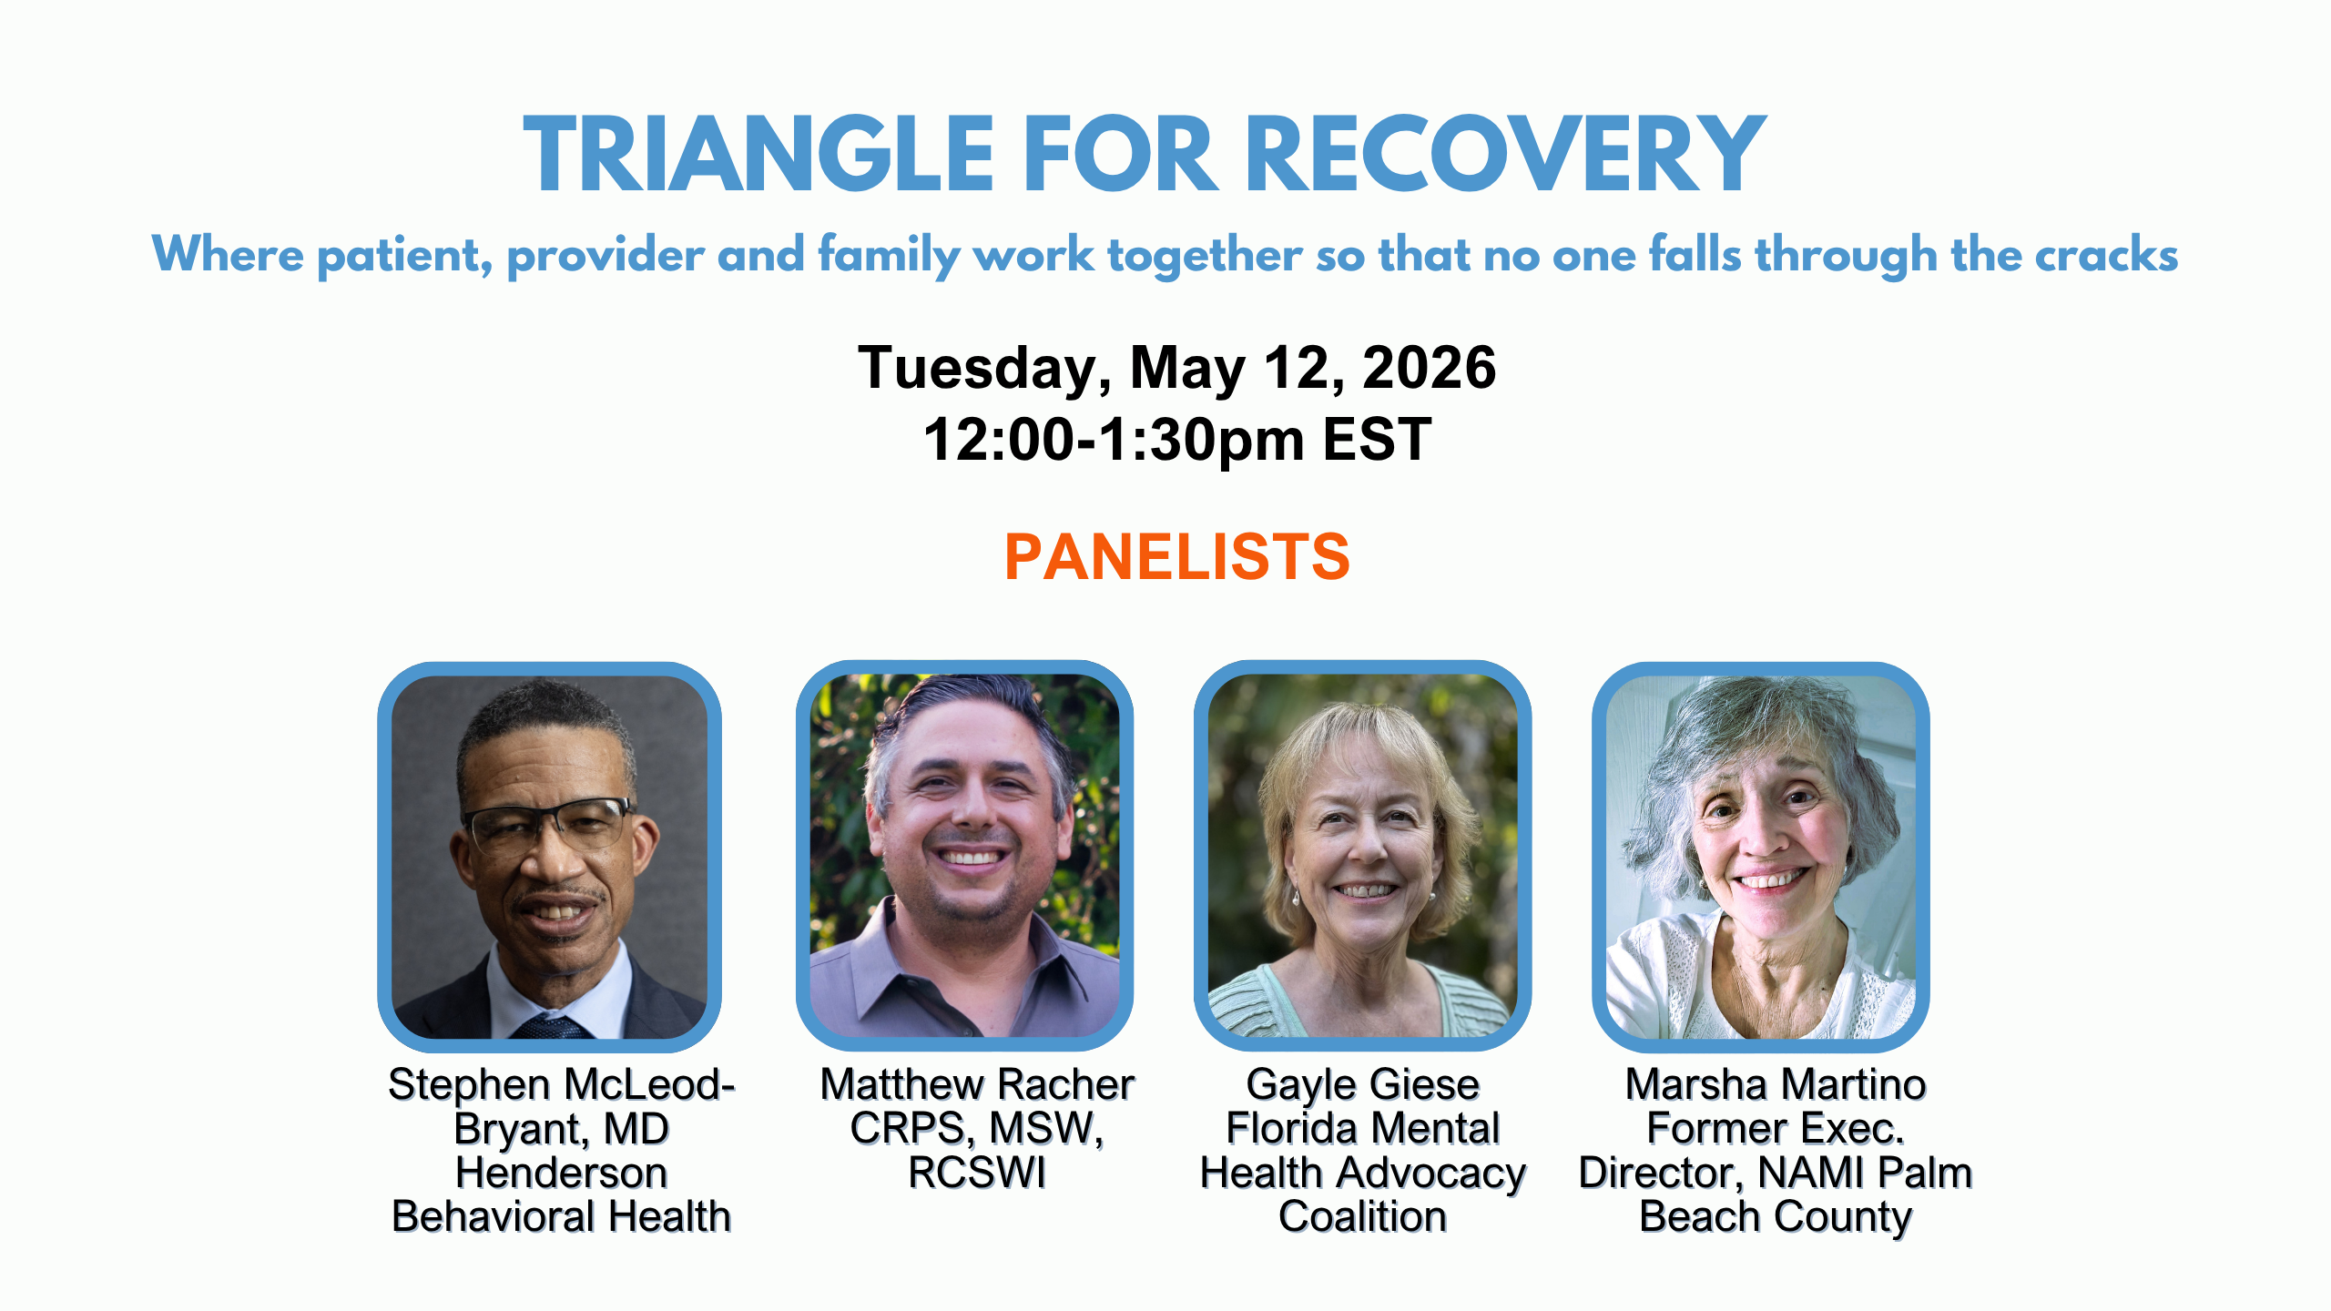
Meet Our Panelists
Matthew Racher, MSW, CRPS, RCSWI
Matthew M. Racher is a social worker with specialized experience in mental health care, harm reduction, and trauma-informed practice. He holds a Master of Social Work from Barry University, where he focused on evidence-based and trauma-informed treatment approaches, and is a Certified Recovery Peer Specialist.
Drawing from lived experience with major depressive episodes and psychosis, Matthew brings an informed and empathetic perspective to his work, which has meaningfully shaped his commitment to the mental health field.
He is passionate about early intervention, peer and family support, and strengthening community-based care. Matthew is currently advancing toward licensure as a Licensed Clinical Social Worker (LCSW) and is dedicated to providing compassionate, client-centered support to individuals on their path to recovery.
Notes:
Katherine. Add photos and bios

Slide 8
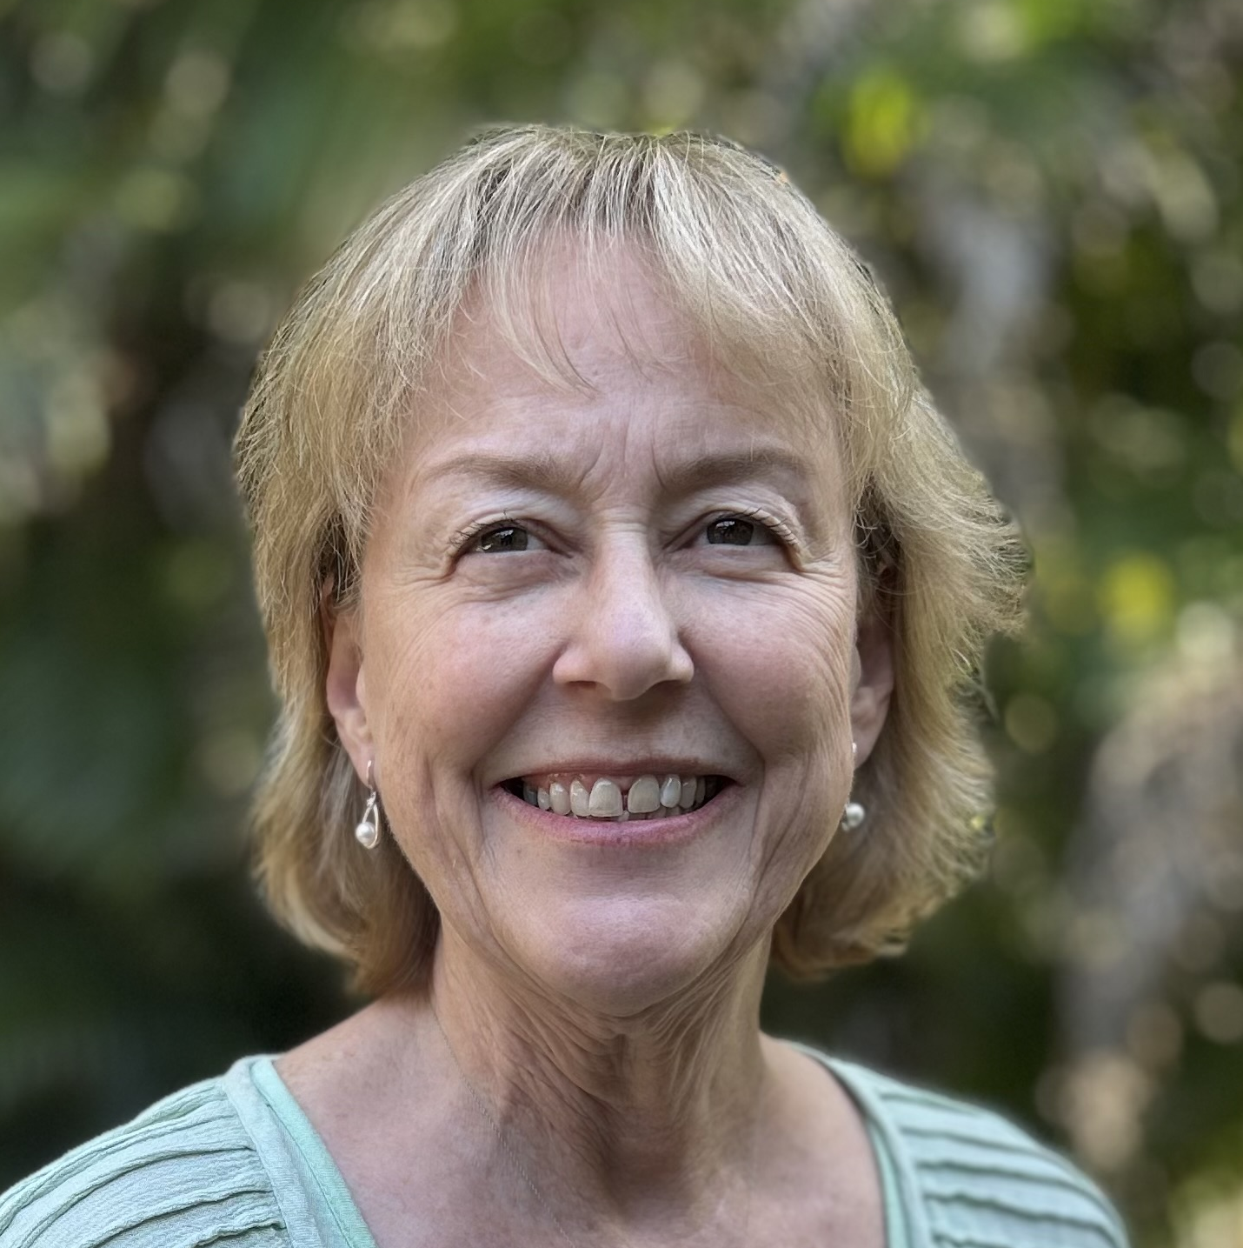
Meet Our Panelists
Gayle Giese
Parent; Founding Member and Coalition Leader, Florida Mental Health Advocacy Coalition; and Board Member, Florida Advocates for Behavioral Health
Gayle is a founding member and Coalition Leader of the Florida Mental Health Advocacy Coalition, a board director for Florida Advocates for Behavioral Health, and a former NAMI Florida and Florida Supportive Housing Coalition Board Director.
She is the mother of an adult child with a serious mental illness. She has received community mental health awards from MHA of SE Florida and South Florida Wellness Network. She spoke on a NAMI National Conference panel about 988 State Advocacy and was awarded NAMI national’s Betsy and Richard Greer Award for Advocacy in 2024.
Notes:
Katherine. Following this slide, the focus is on the speakers until the HIPAA slide later.

Slide 9
Meet Our Panelists
Dr. Stephen McLeod-Bryant, MD
Dr. McLeod-Bryant received his BA and MD at the University of Rochester and completed his residency in psychiatry at the Tufts-New England Medical Center in 1988. He has served on the faculty of the Department of Psychiatry and Behavioral Sciences of the Medical University of South Carolina (during which he served two years as the Medical Director of the SC Department of Mental Health), Meharry Medical College, and University of Miami.
He has been a Life Fellow of the American Psychiatric Association (APA), President of the South Carolina Psychiatric Association, and served as the APA Caucus of Black Psychiatrists’ Representative to the APA’s Assembly from 2003-2016. He serves as Immediate Past President of the Black Psychiatrists of America. He is a recipient of the American Psychiatric Association’s Solomon Carter Fuller Award and a member of the American College of Psychiatrists.
He is now splitting his clinical time between a small private practice in Coral Gables, being a staff psychiatrist at Henderson Behavioral Health, and providing two half-days of service at the Dade County Street Response Clinic of Miami Street Medicine.
Notes:
Katherine. Add photos and bios

Slide 10
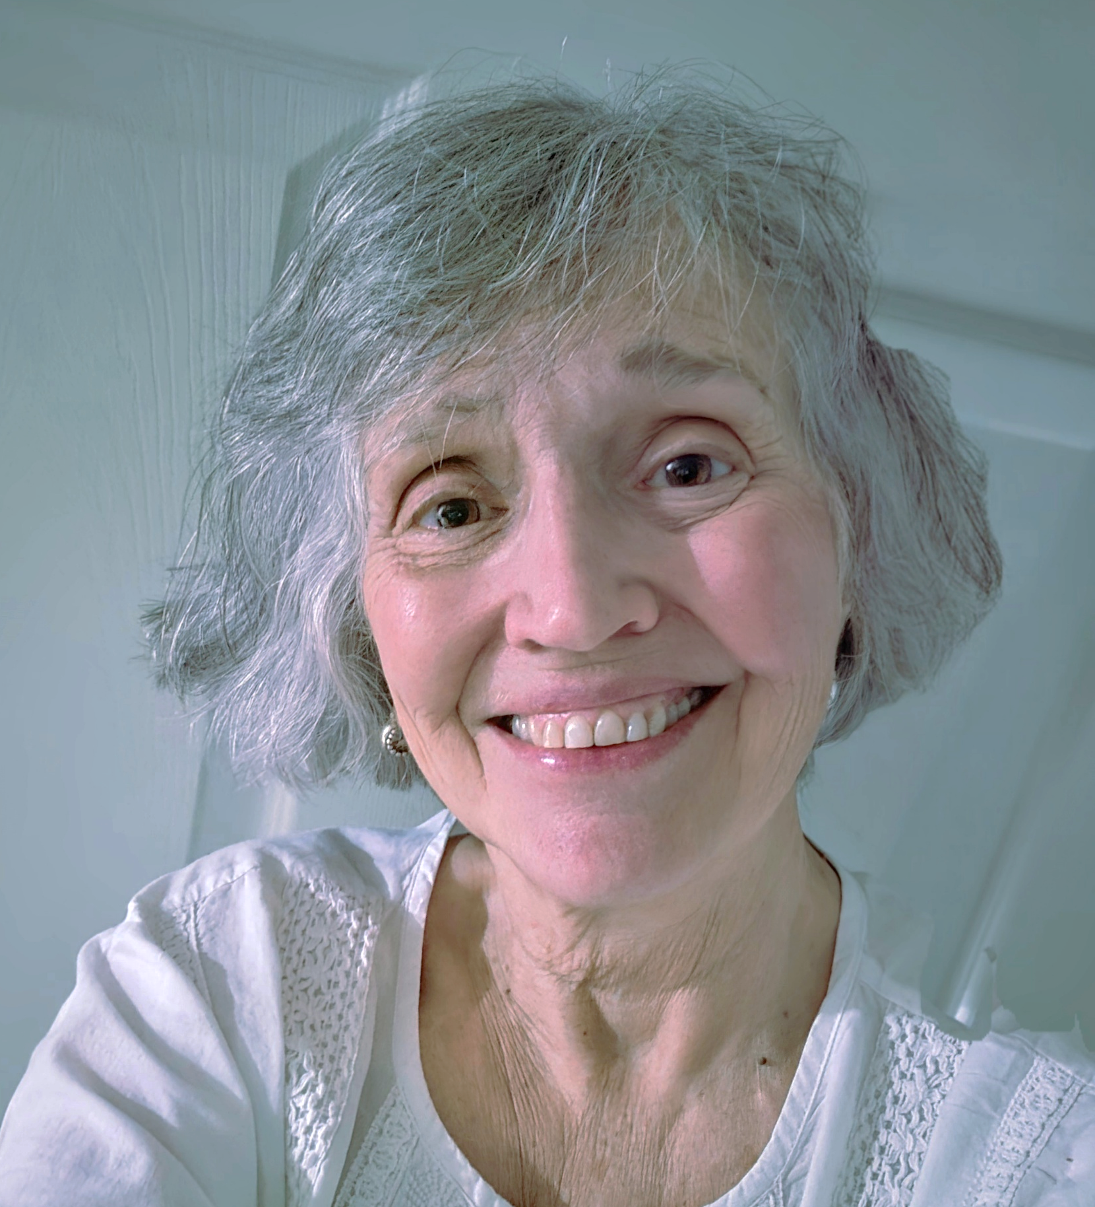
Meet Our Panelists
Marsha Martino
Parent and Former Executive Director NAMI Palm Beach County
Marsha Martino has been involved with NAMI Palm Beach County since 2010, having served for four years on the NAMI Palm Beach County Board of Directors and then
seven years as Executive Director. Since retiring in 2023, Marsha has continued to
volunteer with NAMI Palm Beach County as a Family Support Volunteer, providing
individualized support to families whose loved one is in need of behavioral health
support, teaching Family-to-Family classes, and co-facilitating NAMI Family Support
Groups.
Marsha’s prior work experience includes 25 years of developing and managing
programs in Maine for individuals with neurological issues. In Florida, Marsha managed
programs for individuals living with developmental disabilities, cystic fibrosis, and adult
and juvenile justice issues. She has a passion for problem-solving and educating
families of individuals who have multiple diagnoses and complex needs, including those
living with high functioning autism. Marsha and her husband are parents of two adults
who have had struggles with mental health, autism, and addiction issues.
Notes:
Katherine. Following this slide, the focus is on the speakers until the HIPAA slide later.

Slide 11
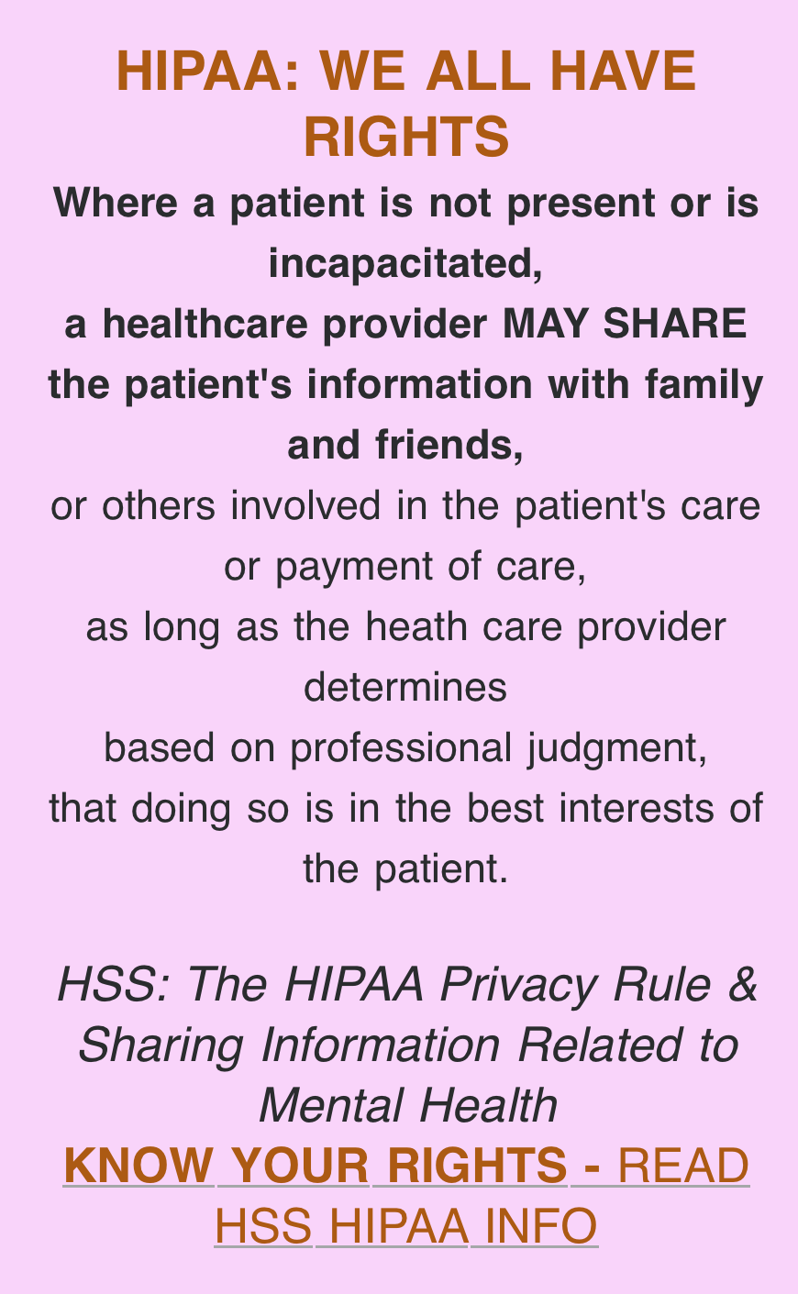
HIPAA
HIPAA stands for the Health Insurance Portability and Accountability Act of 1996. It is a federal law designed to protect sensitive patient health information from being disclosed without consent. The “Privacy Rule” regulates how Covered Entities (providers, plans) share Protected Health Information (PHI)
Patients must sign a release to allow others to have access to their patient health information.
However, family members CAN provide information directly to the treatment team even if the patient does not sign a release form.

Slide 12
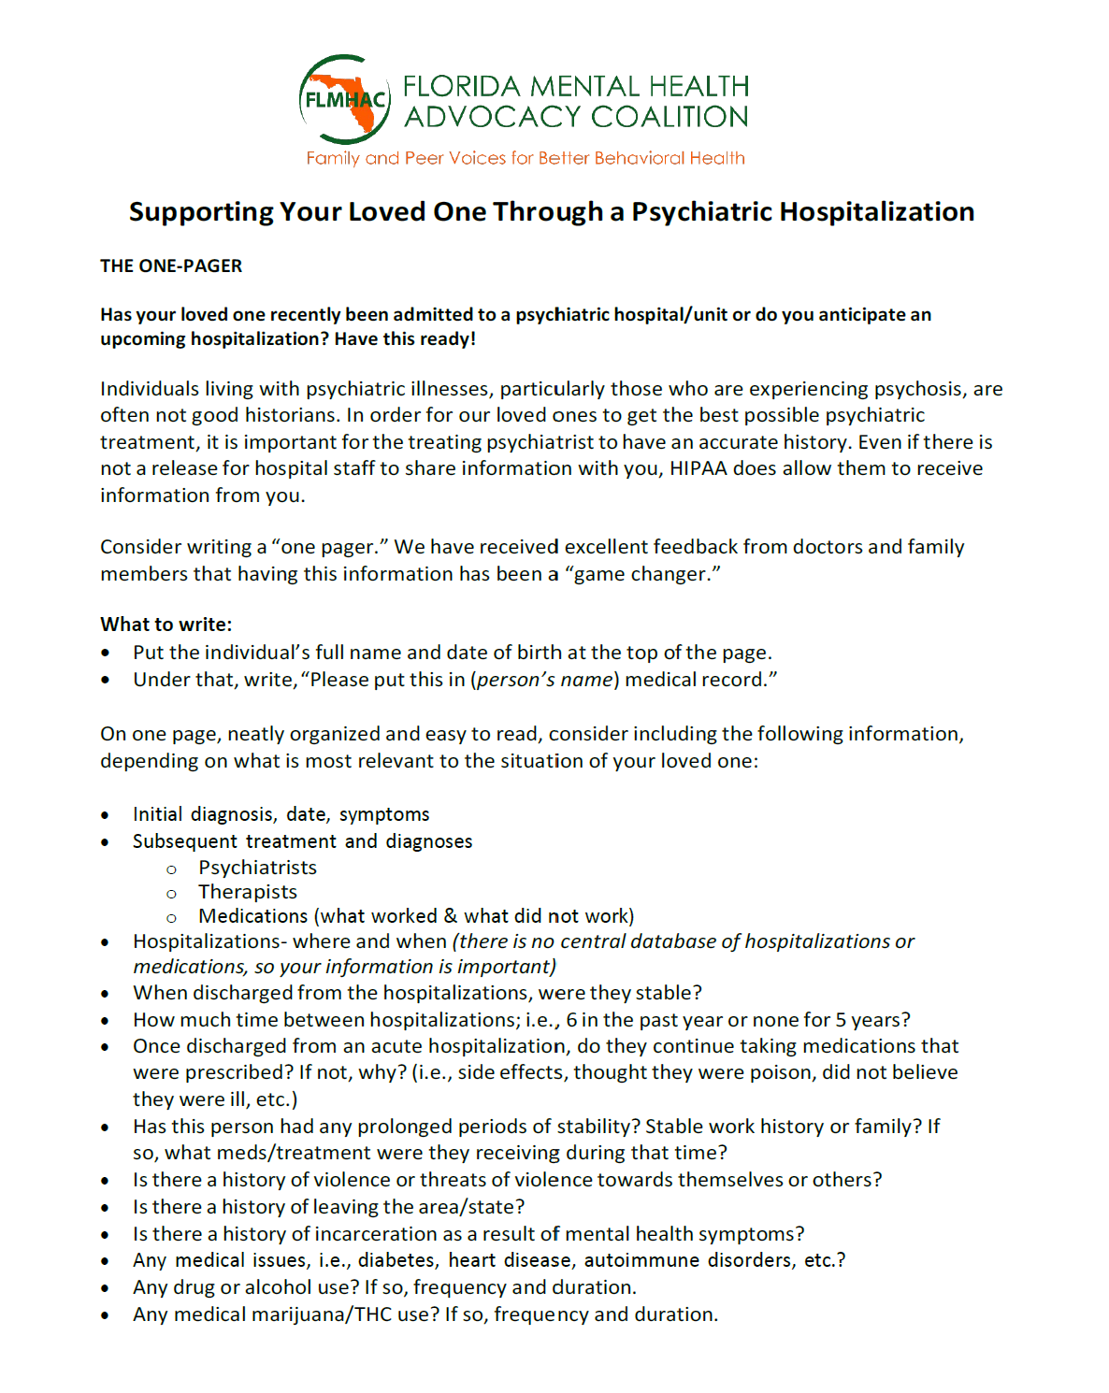
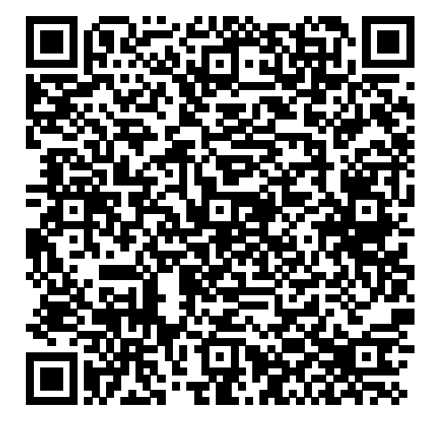
Supporting Your Loved One Through A Psychiatric Hospitalization by Marsha Martino
https://flmhac.org/downloadable-fliers
Notes:
Marsha to describe what is in the guide.

Slide 13

NAMI Resources for Helping Caregivers
NAMI Programs – Family to Family, Family Support Group
NAMI Crisis Plan
NAMI HelpLine: (includes special line for Caregivers): 1-800-950-NAMI or TEXT “Helpline” to 62640. Available M-F, 10am-10pm.
https://www.nami.org/family-members-and-caregivers/
Notes:
Marsha to describe. Katherine to help.

Slide 14
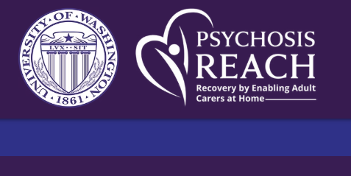

https://www.psychosisreach.org/
University of Washington’s SPIRIT LAB.
Psychosis REACH was developed for families, with families.
Experts in Cognitive Behavioral Therapy for Psychosis and Family Interventions teamed up with families with lived experience to develop the Psychosis REACH training model.
Psychosis REACH teaches concrete, evidence-based skills that are rooted in CBT.

Slide 15


https://curesz.org/friendsz/
Comprehensive Understanding via Research and
Education into SchiZophrenia
The CURESZ Foundation offers advocacy, information, advice, as well as educational and supportive resources to enhance the understanding of schizophrenia as a treatable neuropsychiatric illness.
CureSZ Friendsz are a network of family members and close friends of people who have schizophrenia. These people are available to offer you encouragement, friendship, and support on your journey.
Notes:
Gayle to give brief explanation

Slide 16
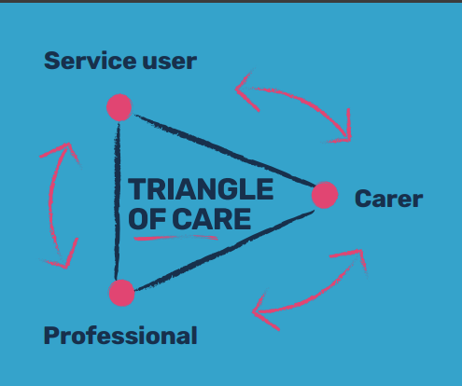
What is the UK Triangle of Care?
The Triangle of Care is a therapeutic alliance between (unpaid) carers, service users and health professionals.
It aims to promote safety and recovery and to sustain wellbeing in mental health by including and supporting carers.
The Triangle of Care is based on six principles that healthcare providers can use to include and support carers.
https://carers.org/triangle-of-care/the-triangle-of-care

Slide 17
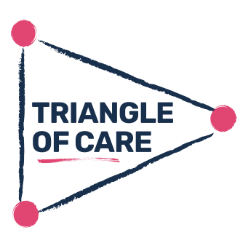
Six Principles for Providers
Carers and the essential role they play are identified at first contact or as soon as possible thereafter.
Staff are ‘carer aware’ and trained in carer engagement strategies.
Policy and practice protocols regarding confidentiality and sharing information are in place.
Defined post(s) [staff] responsible for carers are in place.
A carer introduction to the service is available, with a relevant range of information across the care pathway.
A range of carer support services is available.

Slide 18
How can the Triangle of Care help health professionals?
• Giving carers and service users realistic expectations and info. to support their caring role.
• Ensuring staff have information about the service users from the unique expertise of the carer.
• Building stronger relationships between staff, carers and service users.
• Reduced admissions – a carer can often recognize signs that a service user is becoming unwell. By listening to carers, steps can be taken to help reduce the need for a service user to be admitted.
Notes:
Commitment to better outcomes! Change in US likely would be driven by health insurance companies and hospital leadership. I am in triangle of care now – mychart. Providers work as a team and invested in getting input. Changes in Baker Act . . . (to next slide)

Slide 19
Baker Act: Discharge Planning: 2024 Updates
Requires the receiving facility to coordinate face-to-face or through electronic means, while in the presence of the patient, discharge plans and to include a personalized crisis prevention plan.
Requires receiving facilities to have a staff member engage a family member, legal guardian, legal representative, or a natural support of the patient’s, in discharge planning and meet with them face-to-face or virtually to review the discharge plan.
Florida advocates would like to see facilities asking all patients to sign a Release of Information as soon as possible in the intake process to involve family or other principal caregivers.
Notes:
Requires receiving facilities to implement policies outlining strategies for how they will comprehensively address the needs of individuals who demonstrate a high utilization of receiving facility services to avoid or reduce future use of crisis stabilization services.

Slide 20


Slide 21
THANK YOU AGAIN TO OUR WEBINAR SPONSOR
Please note that the views expressed by the speakers do not necessarily reflect those of Florida Advocates for Behavioral Health. Moreover, Florida Advocates for Behavioral Health does not endorse any treatments or therapies as expressed by the speakers.

Slide 22
If you enjoyed our free webinar and believe in our mission, please visit our website and sign up for future webinars. Please also consider a donation to continue our work:
www.floridaadvocates.org
Florida Advocates for Behavioral Health is a tax-exempt organization under the Internal Revenue Code Section 501(c)3. Contributions to Florida Advocates for Behavioral Health are deductible as qualified charitable contributions.

Slide 23
Be sure to complete the survey following the webinar to tell us how we did and to suggest future topics that you want to learn about!

